Slide 1

Team 10

Slide 2

Our approach
Concentrate on the child user
Gamify it with a map and different rooms
Encourage them to participate
Base it on a forum and expand to a community

Slide 3
How it all began
Started with an OpenSource forum
Tried to adapt it to our needs
No luck!

Slide 4
What it is now
9 hours into Code for Good, reality kicked in
Started once again, this time from scratch
Knew we could do the basic functionality
Aimed for a good looking webpages

Slide 5
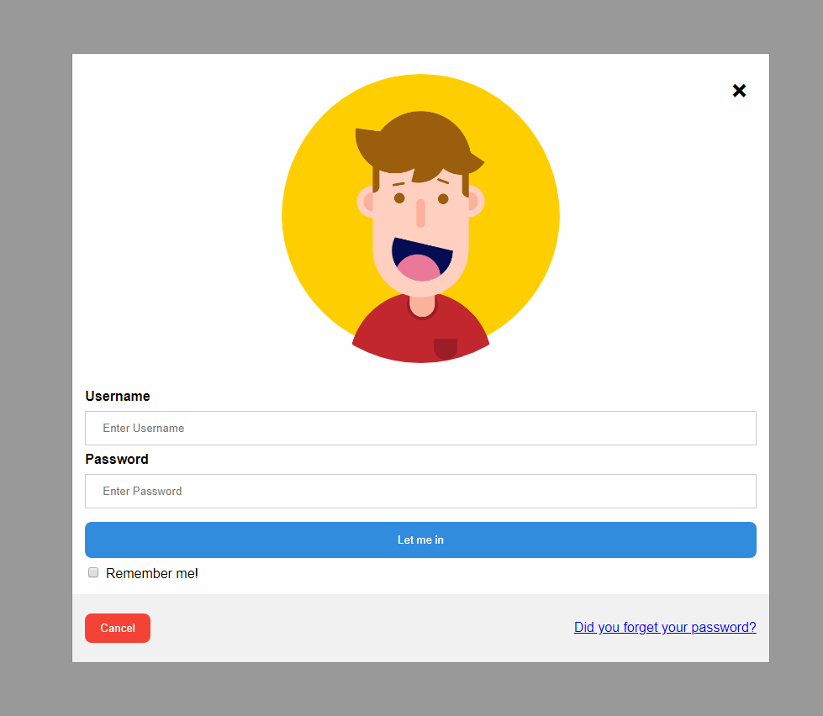
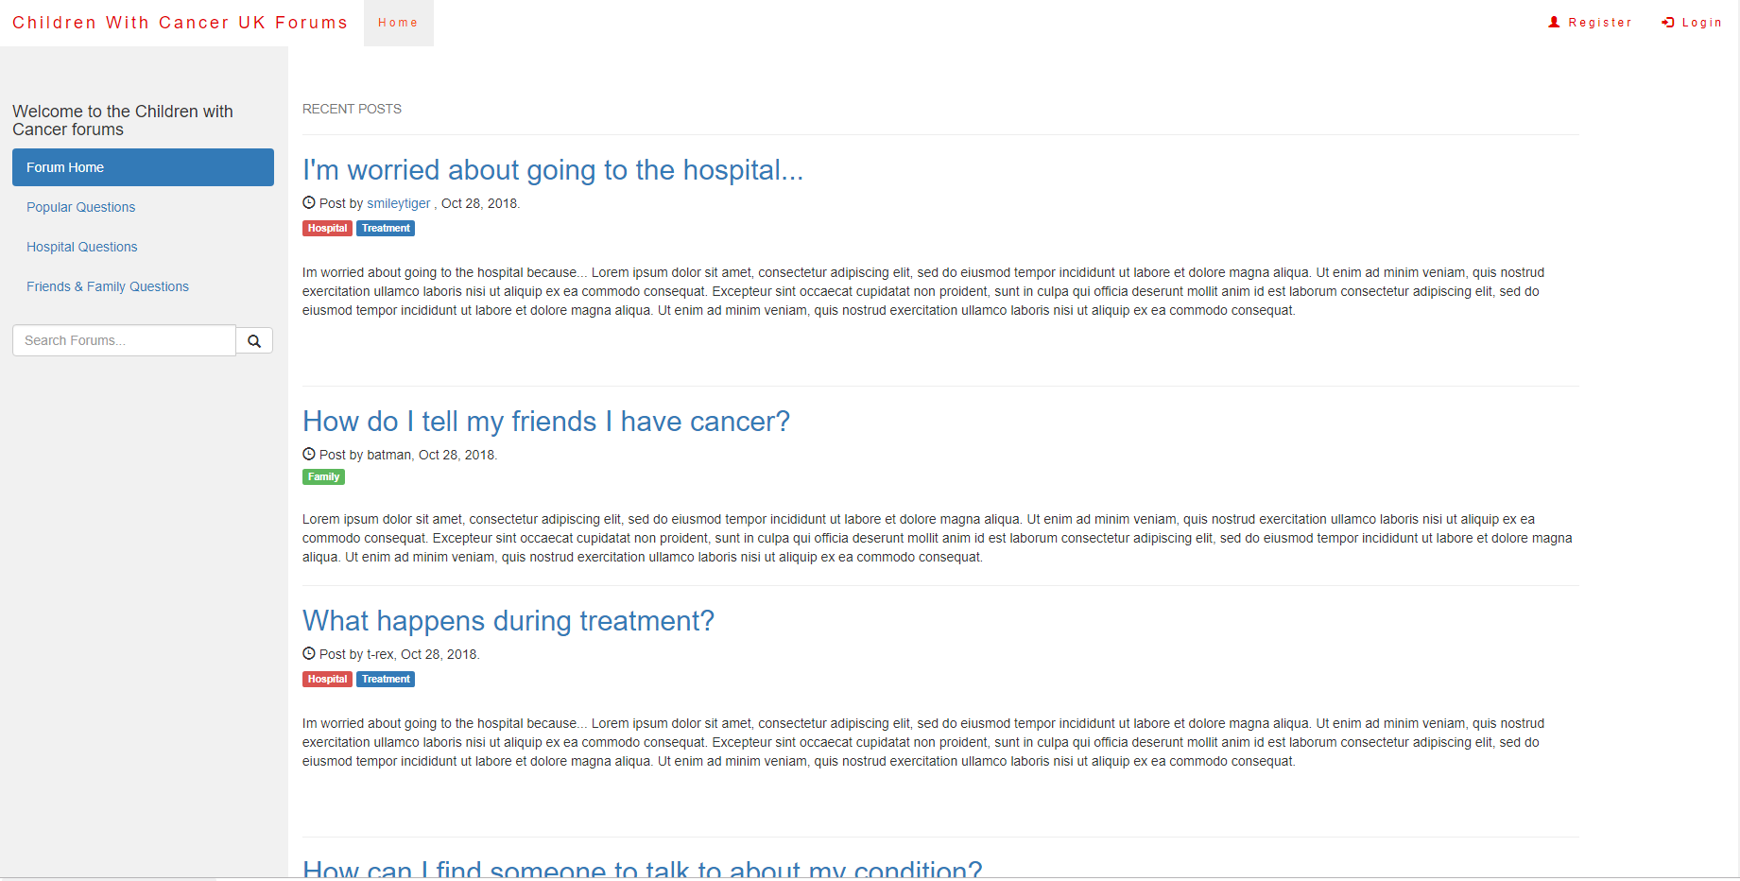
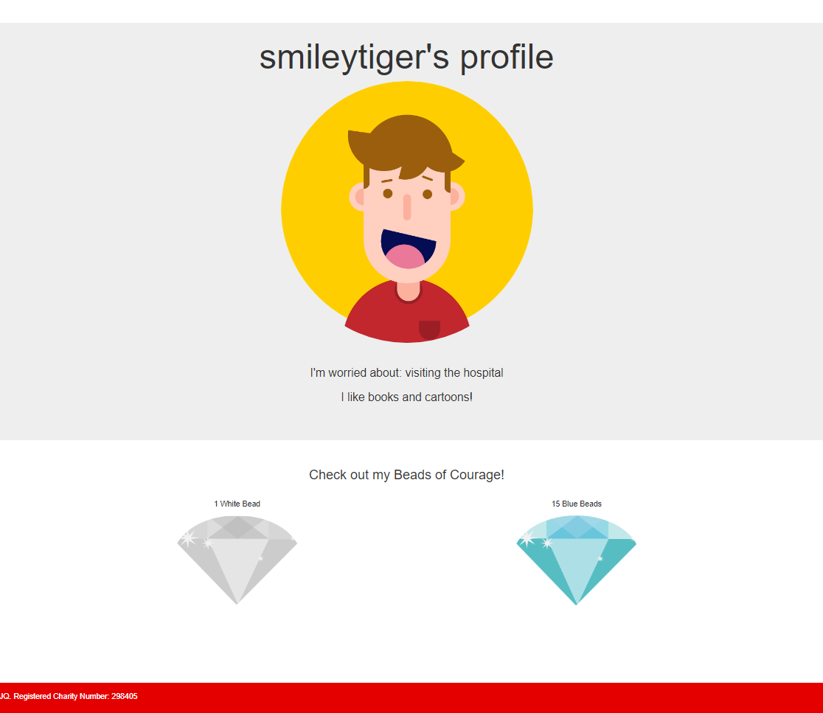
What we have

Slide 6
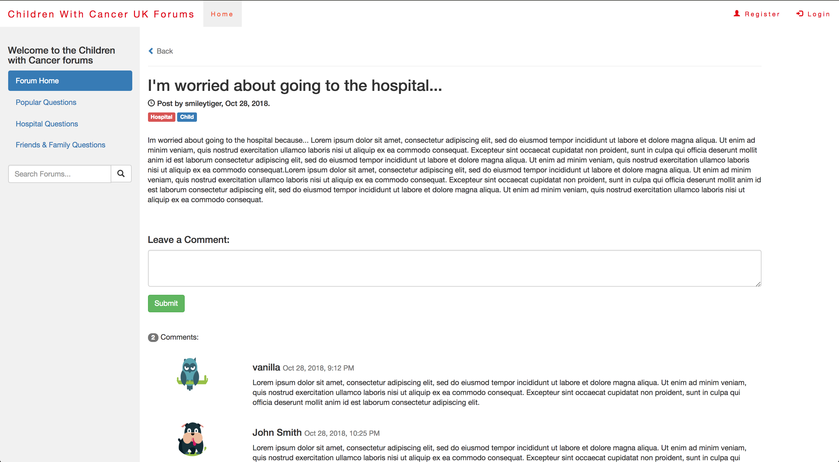

Slide 7
Live demo

Slide 8
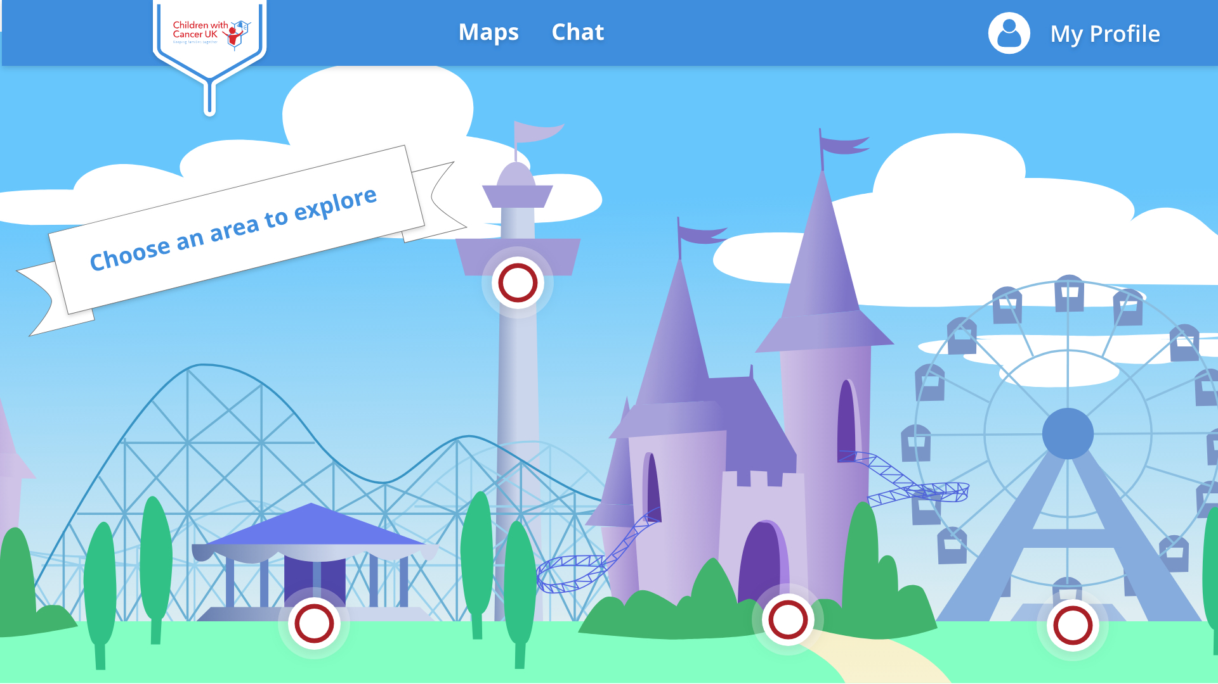
What we envisioned

Slide 9
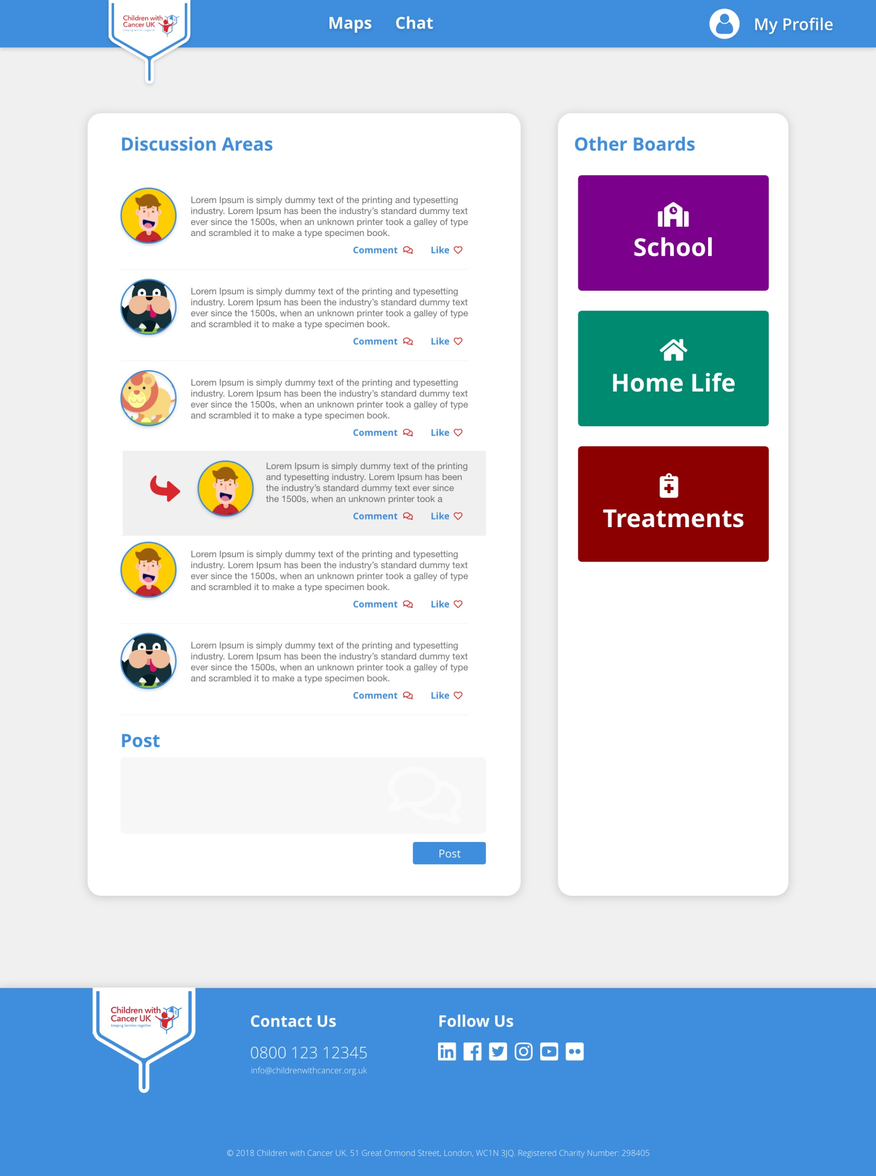
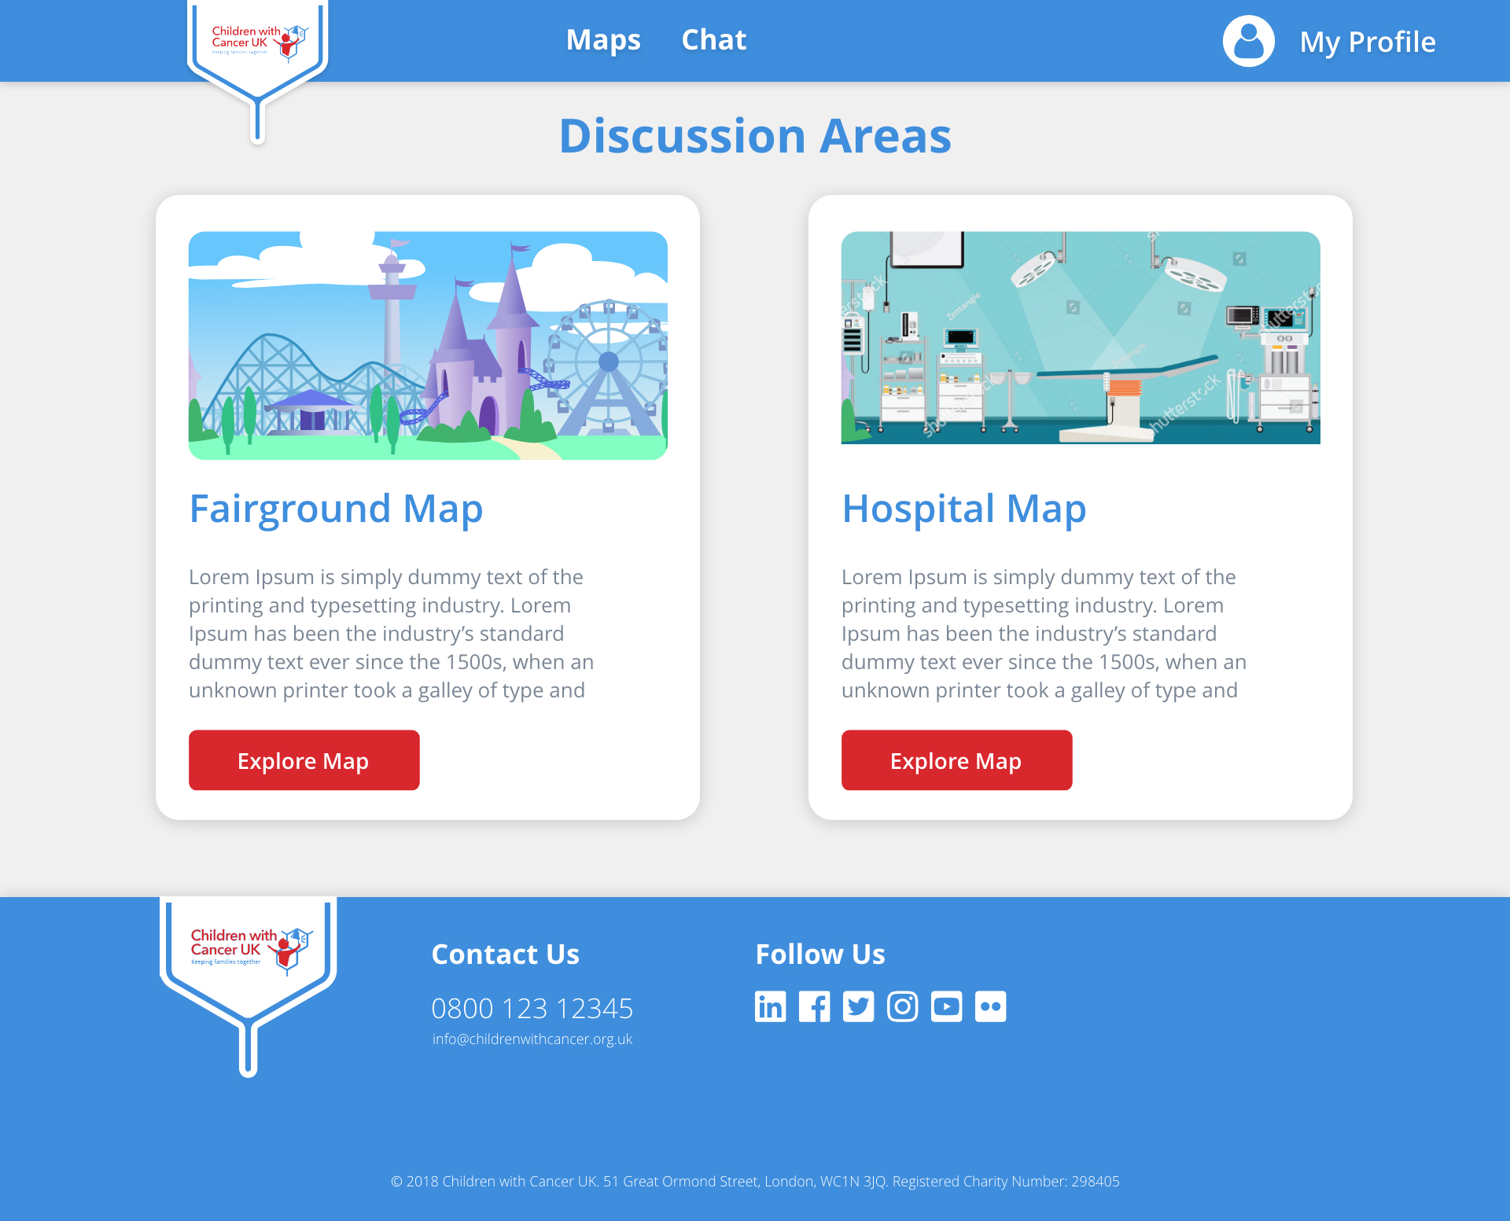

Slide 10
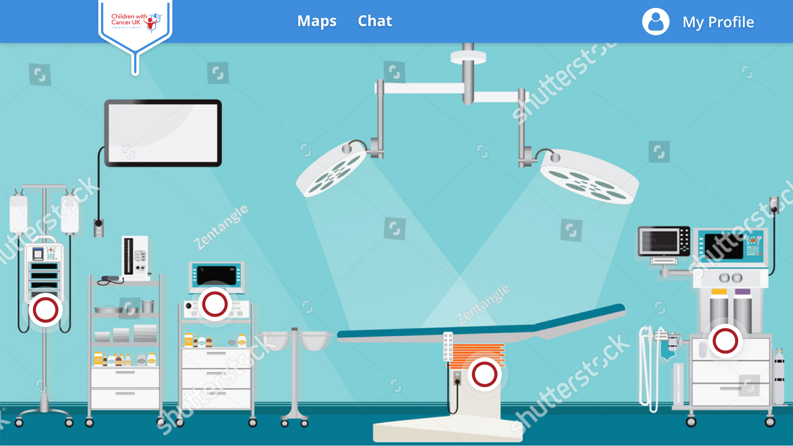

Slide 11
Thoughts for the future
Parents have connected accounts with children
Parents have access to a simplified version of the forum
Build upon the existing post structure to incorporate media rich content
Tailored interface for age demographic
Forum filters to flag potentially inappropriate content

Slide 12
Thank you

